Slide 1
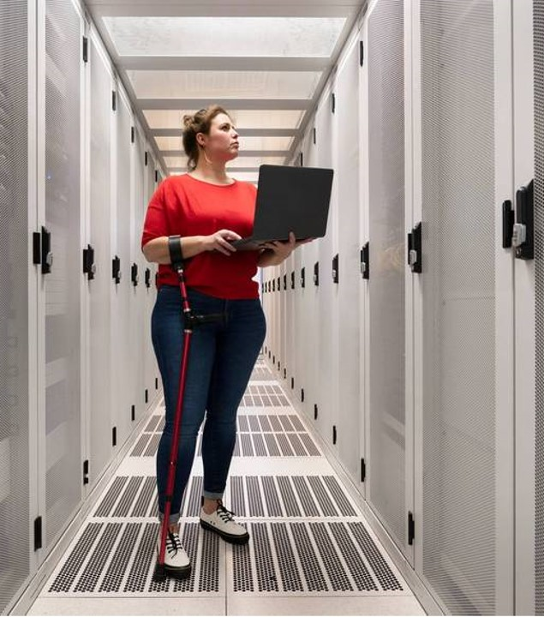
Library Management System
101
Presentation by:
MALACASTE, CHARLES VINCENT

Slide 2


SYSTEM PRESENTATION
o1.
Introduction
o2.
Relevance
o3.
Stakeholders
o4.
Main Features
o5.
E R D

Slide 3

What does my system do?
We will cover these features
Basic concepts
Overview of borrowing and returning of books
System Flow

Slide 4

INTRODUCTION: What is my system?
Managing the borrowing and returning of books is one of the most important parts of running a library. With a Library Management System, this process becomes faster, easier, and more organized. system. The system allows a user to borrow and return a book within the system features.
The Library Management System is designed to simplify and automate the process of borrowing and returning books. It keeps an accurate record of every transaction, ensuring that books are properly tracked from the moment they are borrowed until they are returned. The system updates the status of each book in real-time, helping to prevent issues like double-booking or missing returns. It also maintains borrower history, monitors due dates, and can generate reports when needed. By handling these tasks efficiently, the system reduces manual work for librarians and improves the overall user experience for library members. But note that the system is still in early access version.

Slide 5
Relevance: What’s the importance of my system..
The Library Management System plays a crucial role in modernizing how libraries handle book transactions. Traditionally, borrowing and returning books were done manually, which often led to misplaced records, overdue returns, and inefficient tracking. This system addresses those issues by automating the entire process making it faster, accurate, and easier to manage.
By updating book status in real-time, the system ensures that both librarians and borrowers always know which books are available and which are currently borrowed out. It improves accountability, and saves time for users. The system also provides borrowing history and due dates, helping maintain order and efficiency within the library. Overall, the system is not full version because it still need updates and future adjustments but after all ,It still supports a smoother and more organized library experience.

Slide 6



STAKEHOLDERS: Who can use of my system?
Admin
Librarian
User/Borrower
This users are the important ones, They logged in and out, and can make transactions like borrowing or returning ,they can update their own info but they cant modify the system
A user that can modify the system and manage the system, they can add or update an information of a user, borrower and books
This user can also use the administrative options of the system, but his role for now is only managing books

Slide 7
MAIN FEATURES:
Authentication
Admin Control
Book Management
Borrower Management
Authorization in logins refers to the process of determining what a user is allowed to do after they have successfully logged into a system.
Admins can modify the system, they can also store, update, and delete data of an entity of the system
The system allows admin and librarians to store and update books within the system.
The admin can add a borrower by selecting a user that isn’t fully verified as a borrower yet.

Slide 8
MAIN FEATURES:
User management
System Logging
Borrowing Function
Returning Function
Admin can add users too and updates them, but they cant update user’s passwords or their transaction
System record logs for every activity happens in the system, it helps track for all information that is committed by the system or by the users of the system.
Users or borrowers can borrow a book by using this function in user’s dashboard,
Borrowed books from borrowers can be returned by using this function, failure to return book by the due date will lead to a penalty for overdue books.

Slide 9

SUMMARY
What we’ve learned so far
The Library Management System was built to make borrowing and returning books easier and more organized. Instead of relying on manual logs or paper records, everything is done through the system. Users can borrow a book, see its details, and return it—all in just a few clicks.
With login and authorization in place, only registered users can borrow, and only admins can manage the book list and update records. This helps keep everything secure and in order.
Overall, this system was made to save time, reduce errors, and make the whole borrowing and returning process smoother for both users of the system.

Slide 10

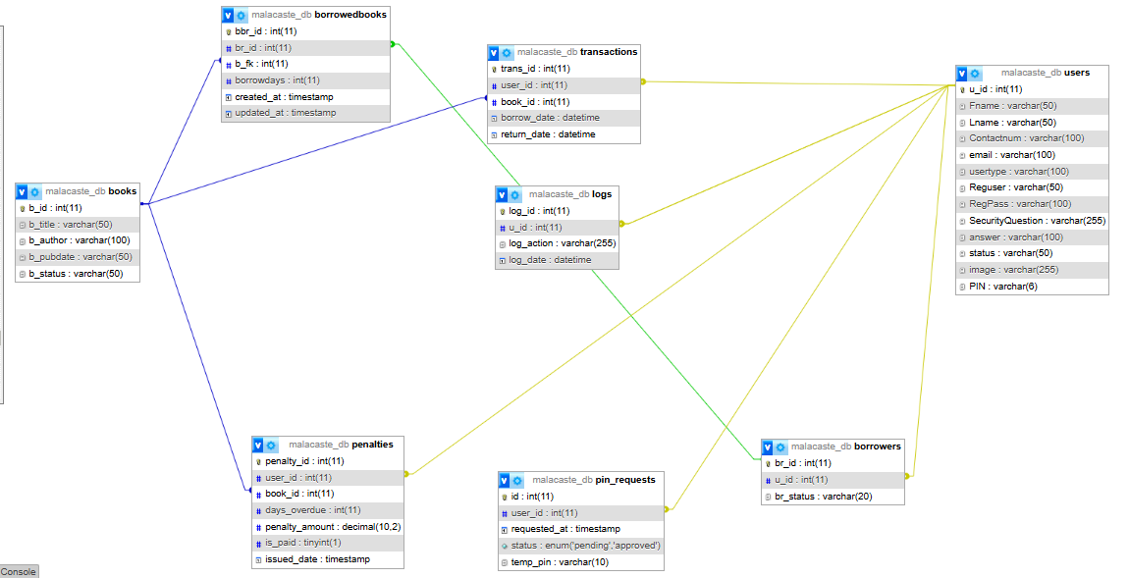
ERD

Slide 11

Thank you

